Slide 1


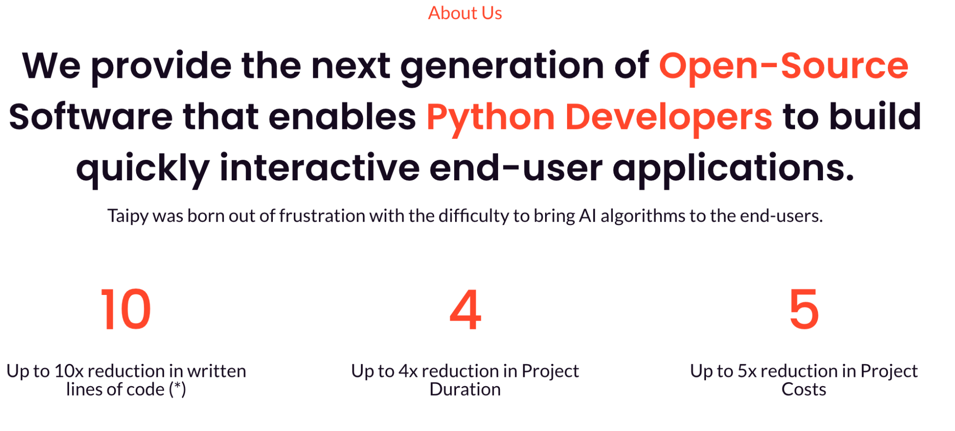
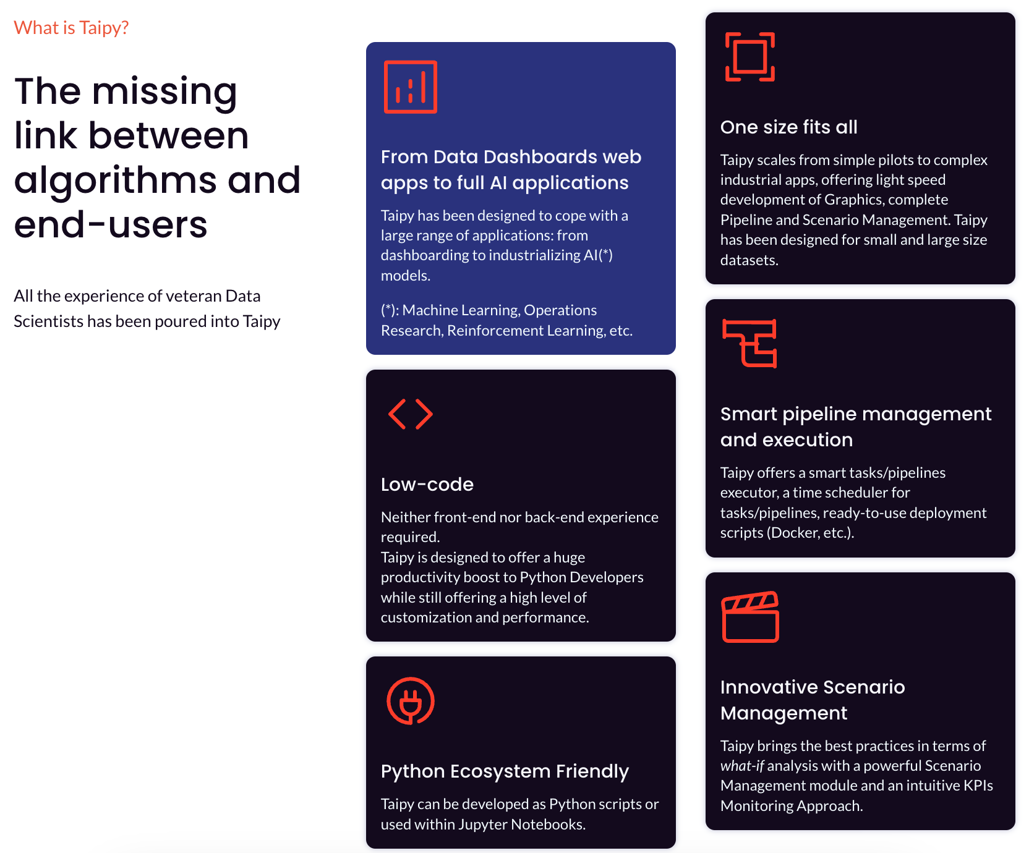
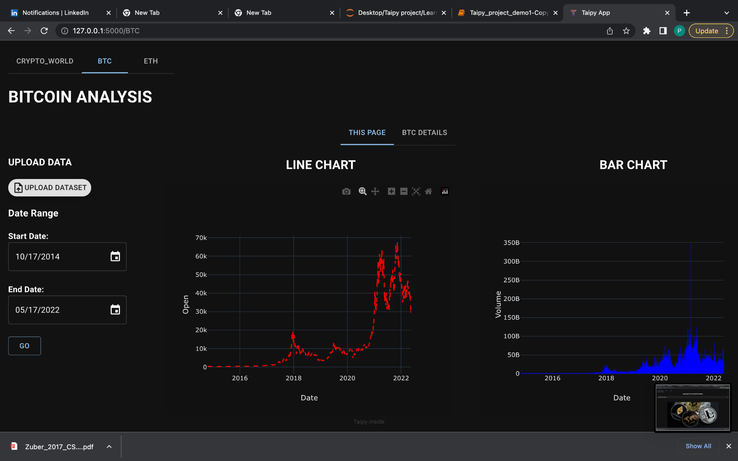
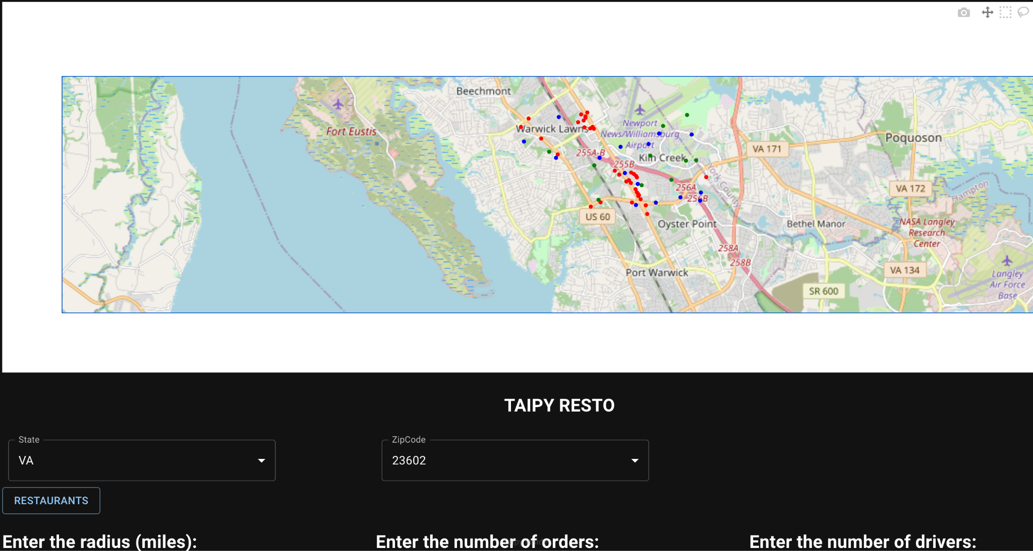
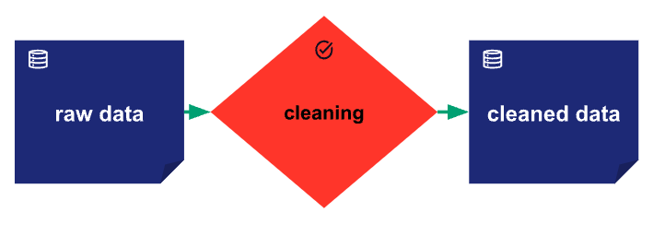
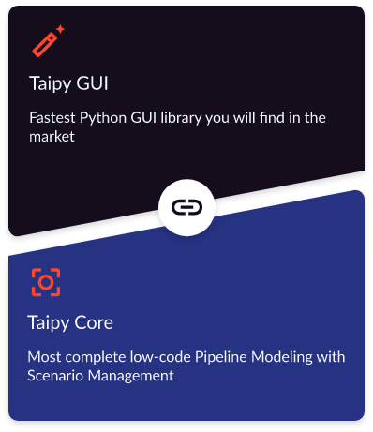
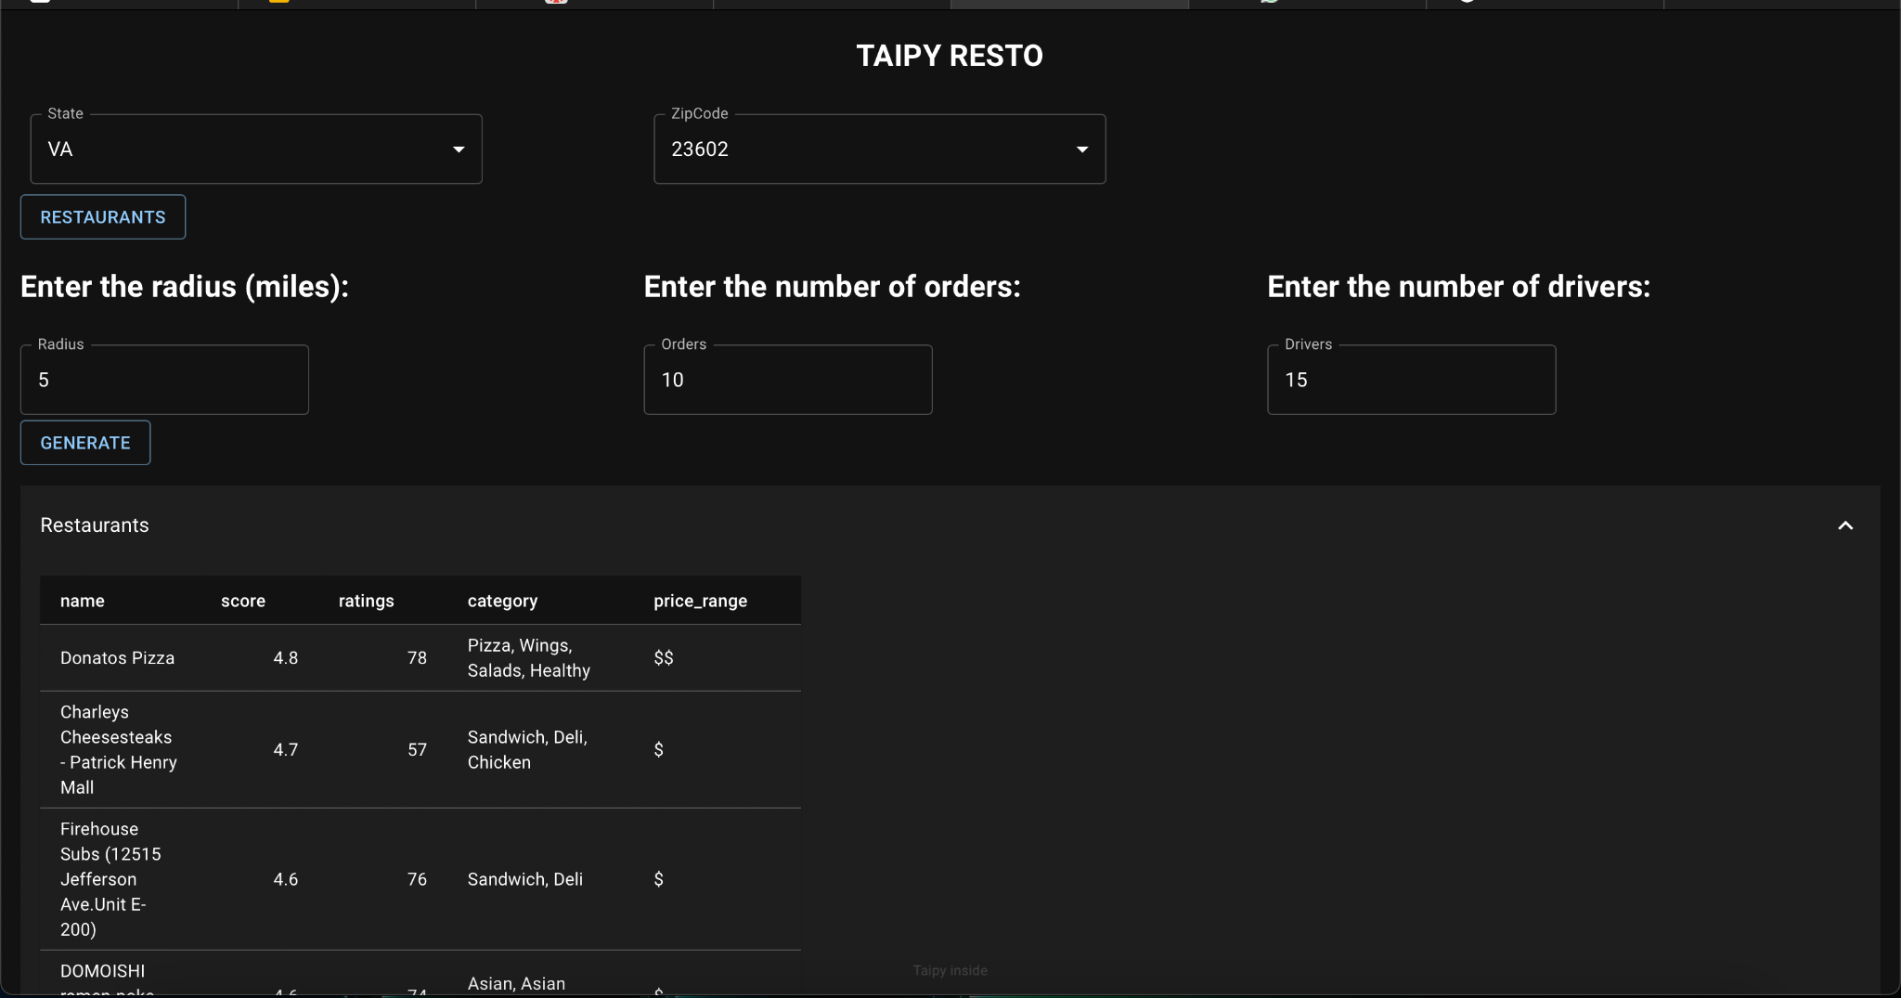
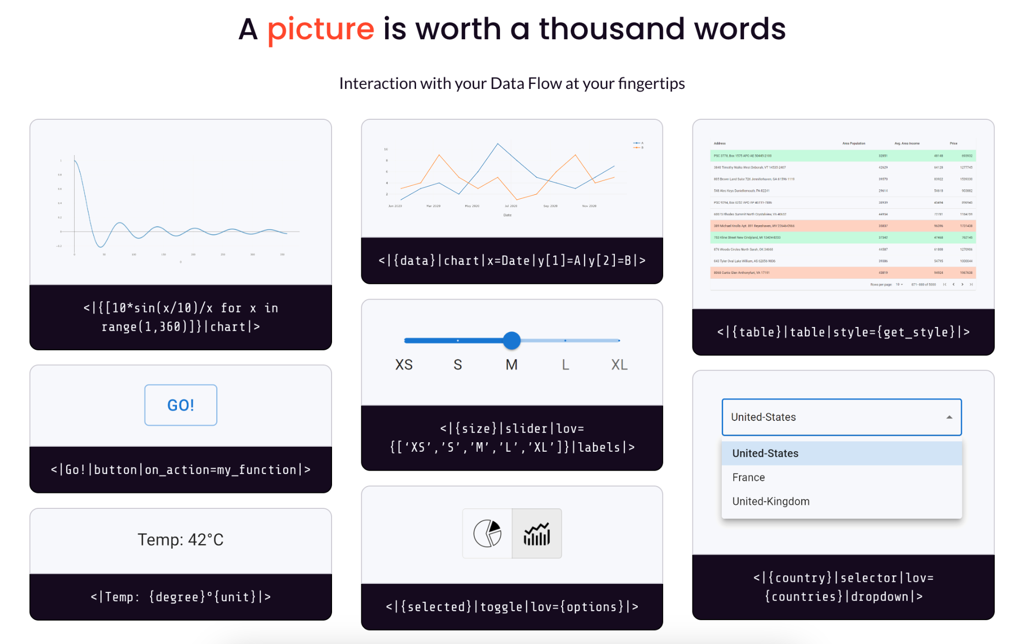
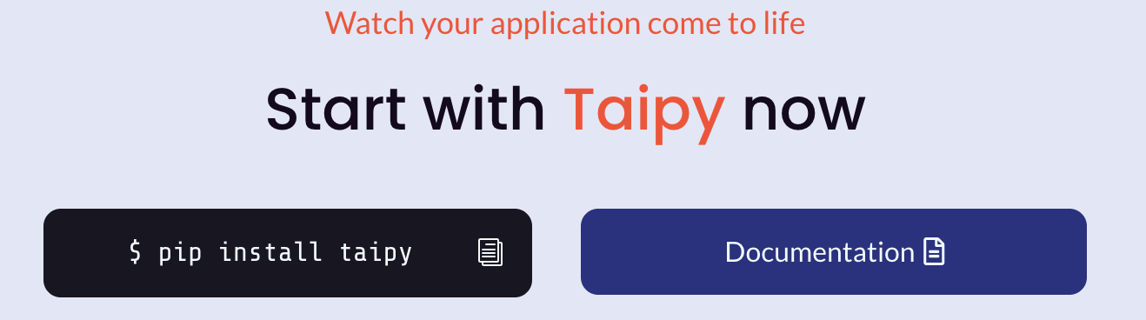
Developing Machine learning and Supply chain Application using Taipy
(Python Open Source Advanced Tools)
Team: Priestley Fernandes, Kavan , Kanika Yadav, Zhaoyi Xu, Richeng Zhang, Syed Qaderie, Rahul Sikinam
Instructor: Alkiviadis Vazacopoulos
Introduction
Results
To develop applications using Taipy: Install Taipy: You can install Taipy using pip, the Python package manager, by running the following command in your terminal or command prompt:
Create a new Taipy project: You can create a new Taipy project by running the following command in your terminal or command prompt:
This will create a new Taipy project in a directory called myproject
Build your application: You can build your application using the Taipy drag-and-drop interface. Taipy provides a variety of widgets and components that you can use to build your application, including buttons, text boxes, and charts.
Deploy your application: Once you have built your application, you can deploy it to a web server or cloud platform using the Taipy command-line interface. Taipy supports deployment to a variety of platforms, including Heroku, AWS, and Google Cloud.
Taipy Core helps Python developers create interactive data-driven applications from their algorithms. It provides pipeline modeling, execution, and monitoring concepts. A pipeline is a succession of data-exchanging functions described as a DAG, which can be simple or complex with Taipy Core.
We used Taipy GUI and Taipy Core to analyze Bitcoin, including trends and statistics. The analysis involves technical analysis and statistical processing, presented in a user-friendly interface.
In Taipy, GUIs are made of generated Web pages served by a Web server hosted by the Taipy application itself.
Taipy provides the class Gui that handles this server and its settings.
The Gui class can hold multiple pages, with text and graphics that show the app's status. This way, users get relevant information. Additionally, some of the elements can trigger application code and take users to other pages with more data.
To create the web pages, you need to provide template text files with placeholders for app data. These visual elements are what users interact with, making them representative and interactive objects.
Taipy Core helps Python developers create interactive data-driven applications from their algorithms. It provides pipeline modeling, execution, and monitoring concepts. A pipeline is a succession of data-exchanging functions described as a DAG, which can be simple or complex with Taipy Core.
There are a lot of reasons for using Taipy GUI:
It fastens the creation of an interactive application.
It easily and efficiently manages variables and events.
Easy visualization with Markdown syntax.
There are a lot of reasons for using Taipy GUI:
It fastens the creation of an interactive application.
It easily and efficiently manages variables and events.
Easy visualization with Markdown syntax.
Using Taipy GUI and Taipy Core, we developed a mapping feature that visually represents Orders, Restaurants, and Drivers on the map with distinct colors.
There are a lot of reasons for using Taipy GUI
Graphical User Interface builder (Taipy GUI): allows any Python developer to create a complex and interactive GUI
It fastens the creation of an interactive application.
It easily and efficiently manages variables and events.
Easy visualization with Markdown syntax.
Taipy Core
Scenario Management (Taipy Core): implements a modern backend for any data-driven application based on your business case.
Taipy Core efficiently manages the execution of your functions/pipelines.
Taipy Core manages data sources and monitors KPIs.
Taipy Core provides easy management of multiple pipelines and end-user scenarios, which comes in handy in the context of Machine Learning or Mathematical optimization.
Conclusion
Taipy allows creation of GUIs using generated web pages.
These web pages are served by a web server hosted by the Taipy application itself.
Class Gui is used to handle server and its settings.
The Gui class can hold multiple pages with text and graphics to show app status.
Visual elements with placeholders for app data are used to create interactive objects for user interaction.
Taipy Core is used to create interactive data-driven applications from Python algorithms.
Taipy Core provides pipeline modeling, execution, and monitoring concepts.
A pipeline is a succession of data-exchanging functions described as a DAG.
Pipelines can be simple or complex with Taipy Core.
Taipy Core helps developers create interactive data-driven applications.
The web pages created for GUIs are customizable using template text files.
Taipy GUIs provide a user-friendly interface in visualizing and interpreting data.
Taipy GUIs can trigger application code and take users to other pages with more data.
Taipy GUIs can be used to analyze Bitcoin trends and statistics.
Technical analysis and statistical processing are performed using Taipy Core.
Taipy Core provides monitoring concepts for the analysis process.
Taipy Core pipelines are used to create the mapping feature.
The mapping feature visually represents Customers, Restaurants, and Drivers on a map.
Distinct colors are used to differentiate between Customers, Restaurants, and Drivers.
The mapping feature is a data-driven application created using Taipy Core.
http://www.stevens.edu/bia
Notes:
Motivation
Turns Data and AI algorithms into full web apps in no time
Open Source

